Slide 1
A Study on Vehicle Loan Default Prediction
Team Details
Batch : PGPDSE-FT Online May21-B
GROUP 6
Vijay Chandra Raj V
Radhika Malik
Vaibhav Banait
N Sandeep Kumar Naik
Presented by -
Mentor : Mr. Ankush Bansal

Slide 2
Problem Definition and Study Approach
Individuals all around the world rely on banks to lend them loans for achieving either their personal or business goals and loans thereby remain a major source of income for the banking sector as well.
The problem we have tried to solve for, is that of the rising non-performing assets (NPAs) in India. Since, default on vehicle loans is a major contributor to the rising NPAs in India, we have chosen the vehicle loan default dataset from Kaggle to detect the probability of defaulter rate well in advance using ML techniques based on various factors using risk analytics.
It is an important problem to solve for, which would help loan lenders to make better, informed decisions on analyzing which customer is more reliable and would be able to pay back the loan.
The value addition would thereby lie in minimizing the risk of borrowers defaulting on the loans, using EDA and various applications of Machine learning like Fraud Detection and Risk Modelling.
The study is also useful in analyzing the important determinants of vehicle loan default.
The study approach is as follows:
Understanding the data
Data cleaning
Data transformation
Data preparation-EDA
Feature Engineering
Model building-Regression/Classification/Clustering
Model evaluation

Slide 3
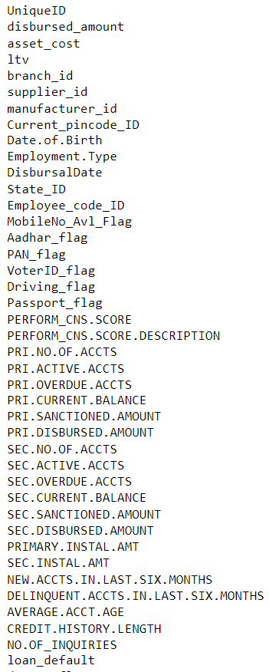
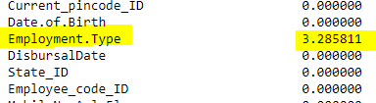
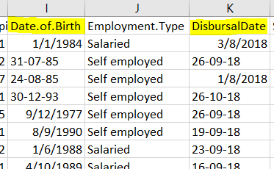
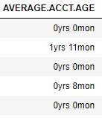
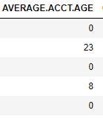
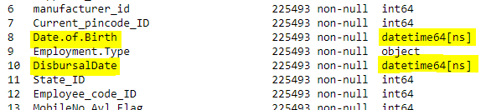
Data Pre-Processing
Dataset Description
Shape: (233154, 41)
Source:
L&T Vehicle Loan Default Prediction | Kaggle
Data Dictionary:
Data Dictionary
Null Value Treatment
Column "Employment type" has 3.28 % null data which is dropped
Handling Special Characters
"Date.of.Birth“ and "DisbursalDate“:
"AVERAGE.ACCT.AGE" and "CREDIT.HISTORY.LENGTH"

Slide 4
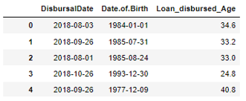
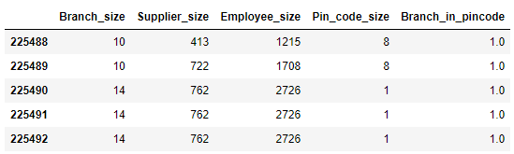
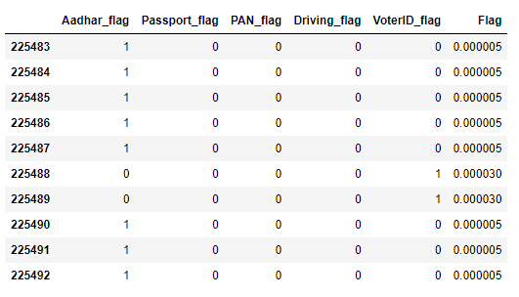
Feature Engineering
* New Column “Loan_disbursed_Age”
* New Column
"Branch_size" – No. of Branches available in a State
"Supplier_size" – No. of Suppliers available for Manufacturer
"Employee_size" - No. of Employee code ID available for Manufacturer ID
"Pin_code_size" - No. of Current_pincode_ID avalilable for Employee_code_ID
"Branch_in_pincode" - No. of branch_id avalilable for pin_code
Drop columns “DisbursalDate” and “Date.of.Birth”
We made use of these columns and we are dropping it since they are in date format
Drop column “UniqueID” - Presence of only unique values
Drop column “MobileNo_Avl_Flag” – Only ‘1’ is present in all columns.
* New Column “Flag”:
* New Column
"Pri_active_acc_ratio" - Ratio of No. of Primary Active accounts to total No. of Primary accounts
"Sec_active_acc_ratio" - Ratio of No. of Secondary Active accounts to total No. of Secondary accounts
"Sec_to_Pri" - Ratio of No. of Secondary accounts to No. of Primary accounts

Slide 5
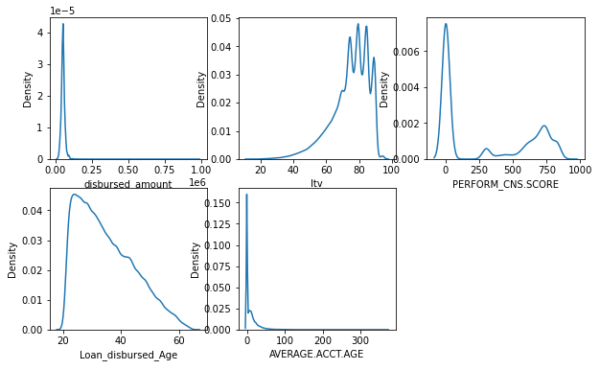
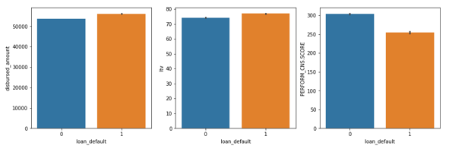
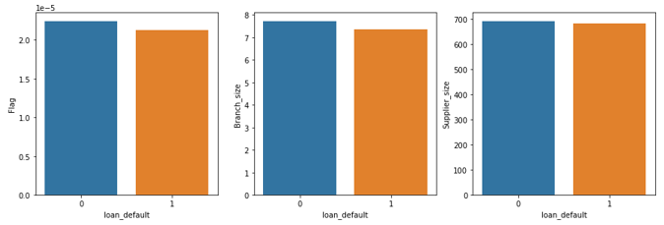
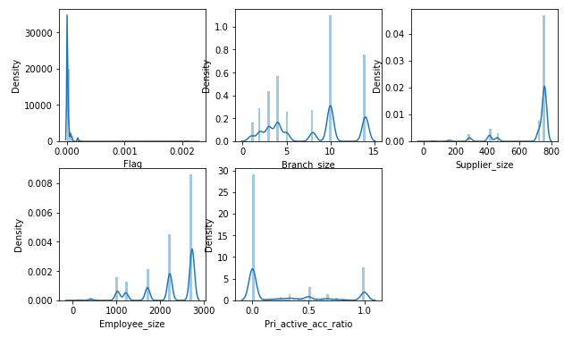
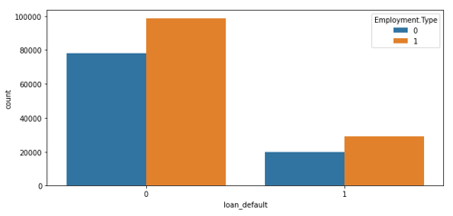
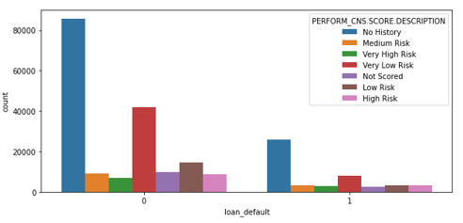
Univariate Analysis
Bivariate Analysis
Existing Numerical Columns
Existing Numerical Columns
Newly Added Numerical Columns
Newly Added Numerical Columns
Categorical Columns

Slide 6
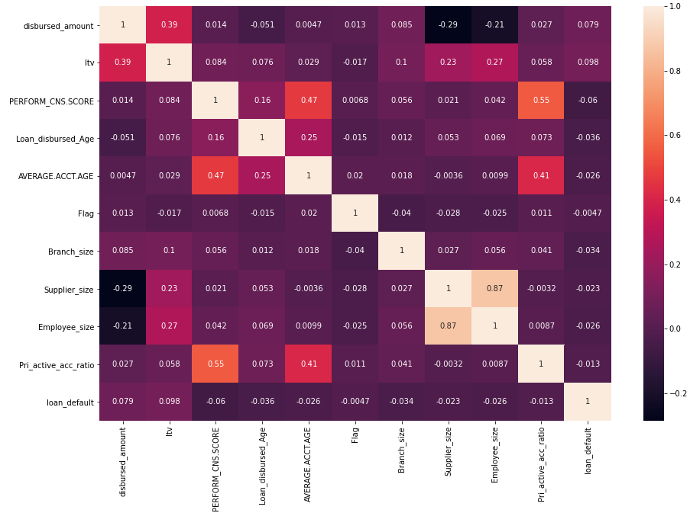
Multivariate Analysis

Slide 7
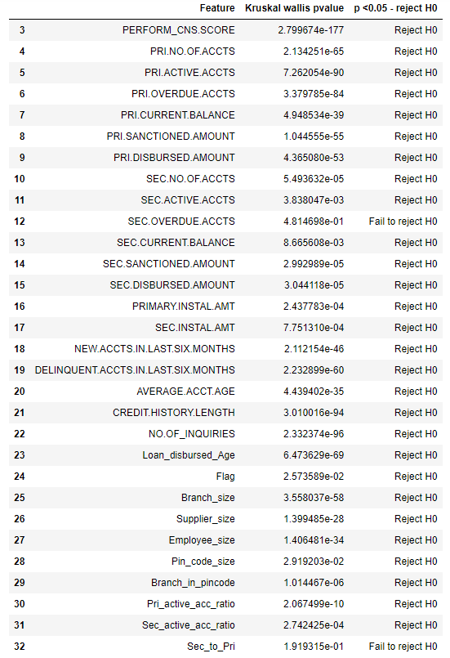
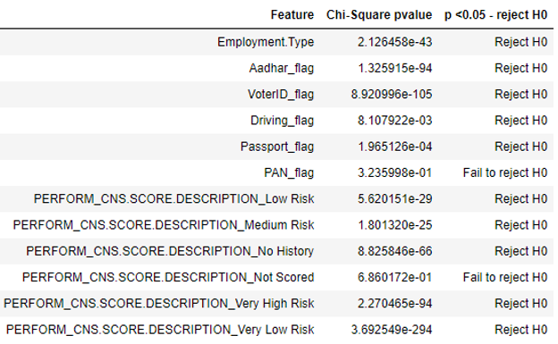
Statistical Tests
Dependency Test : Numerical data Vs Target Variable:
Dependency Test : Categorical data Vs Target Variable:
Kriskal Wallis Test:
Hypothesis:
H0: The Two Features are independent
H1: The Two Features are dependent
Chi Square test
Hypothesis:
H0: The Two Features are independent
H1: The Two Features are dependent
Since the p-value is less than 0.05, we reject the null hypothesis and claim that these features are related to the target Variable
(Except "PAN_flag" and "PERFORM_CNS.SCORE.DESCRIPTION_Not Scored")
Since the p-value is less than 0.05, we reject the null hypothesis and claim that these features are related to the target Variable (Except "Sec_to_Pri" and "Sec.Overdue Accts" )

Slide 8
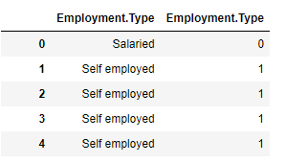
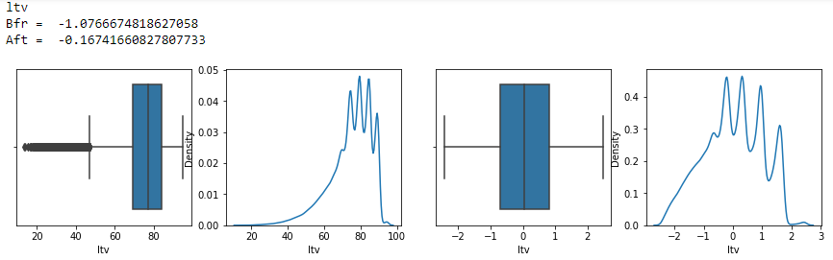
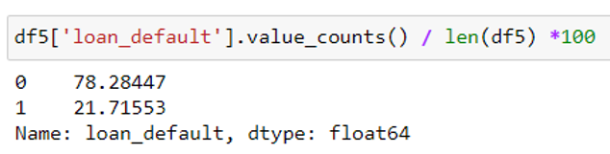
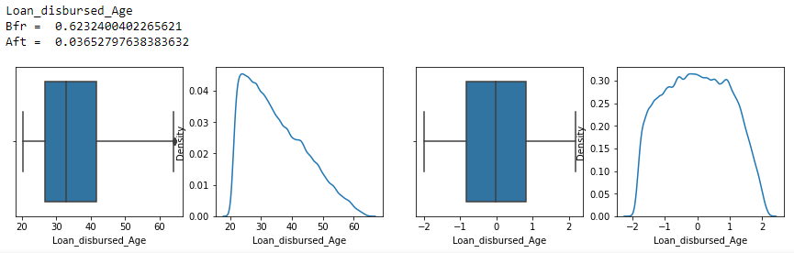
EXPLORATORY DATA ANALYSIS
Encoding Categorical Variables:
One Hot Encoding for features:
“Employment.Type”,
“PERFORM_CNS.SCORE.DESCRIPTION”
Outlier Treatment:
Power Transform and Log Transform for features which showed better skewness after transformation.
Scaling: Using Standard Scalar Function
Data Imbalance Test:
.
Train and Test Split
Train Set – 80% , Test Set – 20%
Train Set :
X_train = (180394, 34), Y_train = (180394,)
Test Set :
X_test = (45099, 34), Y_test = (45099,)

Slide 9
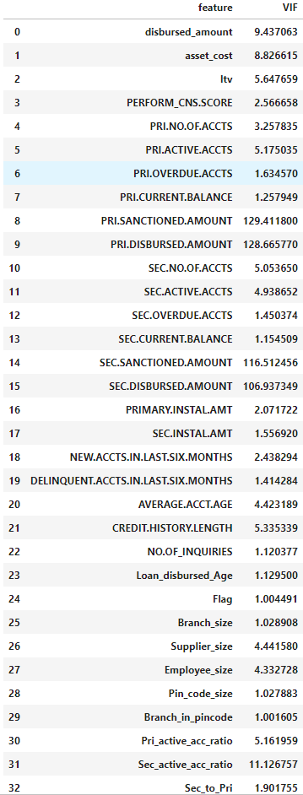
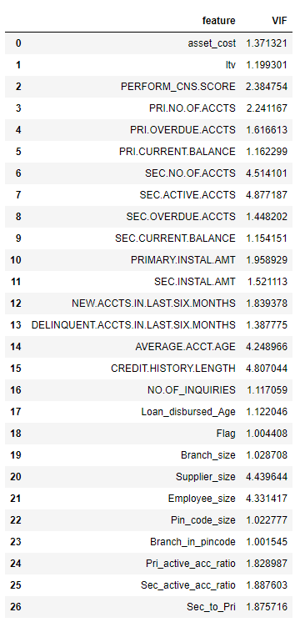
EXPLORATORY DATA ANALYSIS
Multicollinearity Test – VIF method::
After repeating the steps of removing the feature having max VIF value for every iteration, the code have dropped certain columns and finally we achieve VIF values for all the columns less than 5
After VIF Treatment
Before VIF Treatment

Slide 10
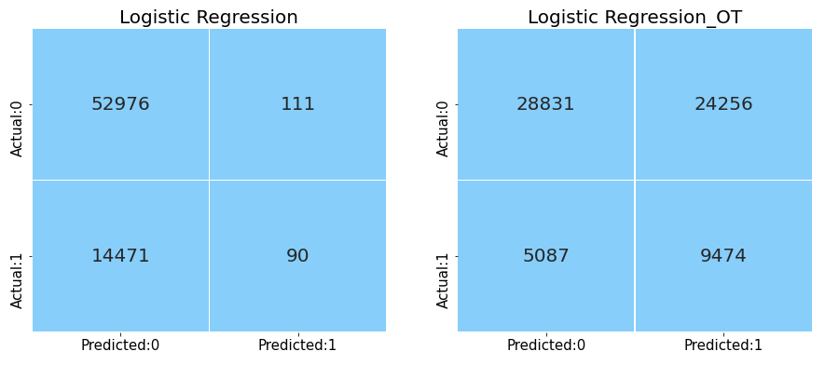
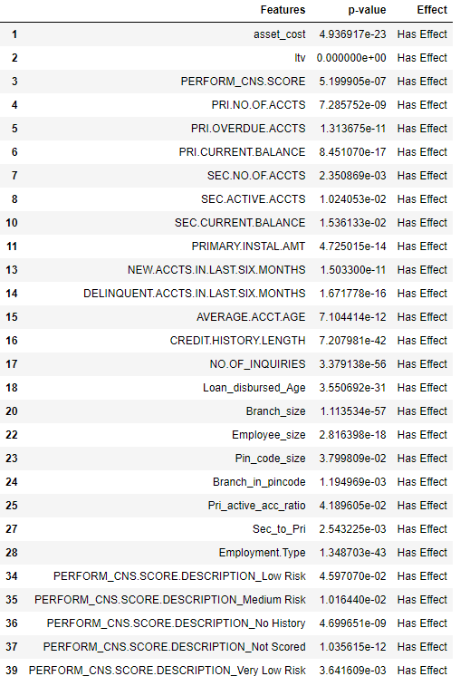
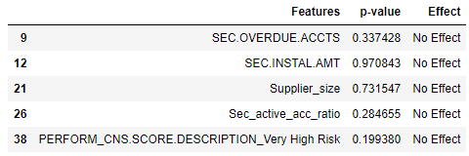
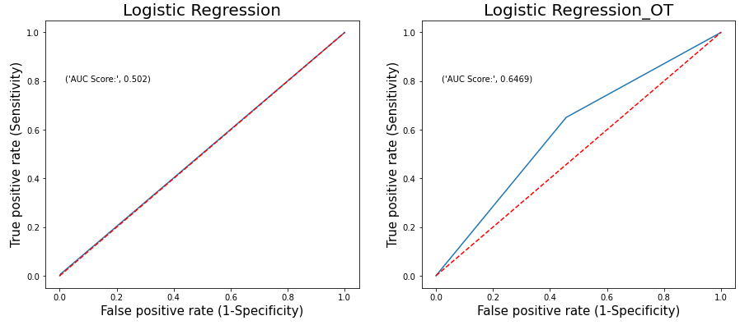
Basic Model
Logistic Regression – Full Model:
Feature Importance:

Slide 11
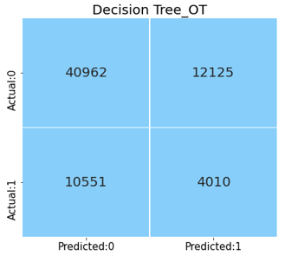
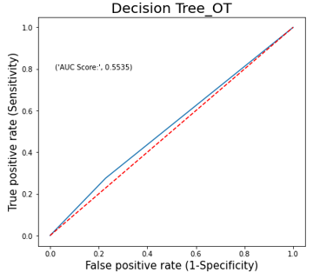
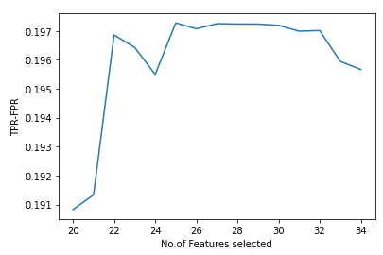
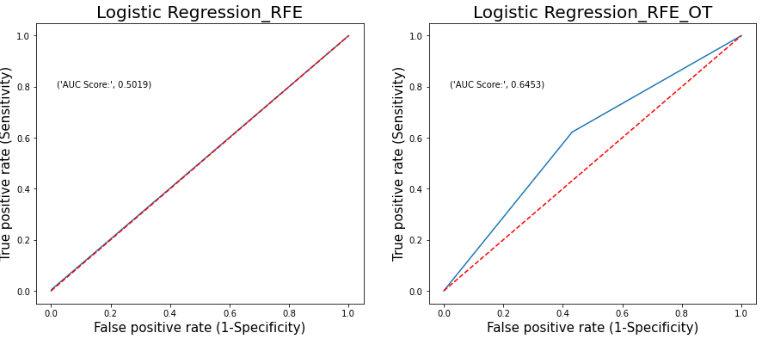
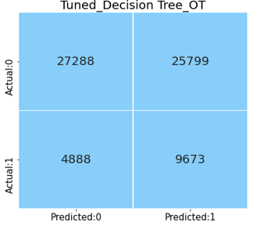
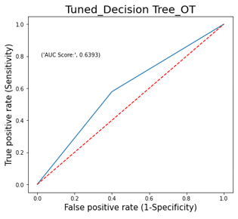
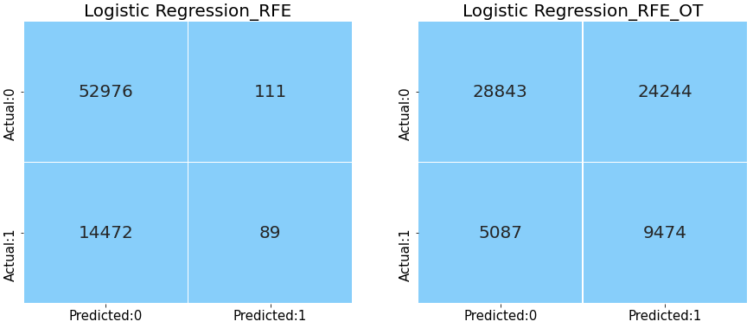
Logistic Regression After RFE
DECISION TREE
RFE method – range(20,35)
25 features >TPR-FPR value
Tuned DECISION TREE

Slide 12
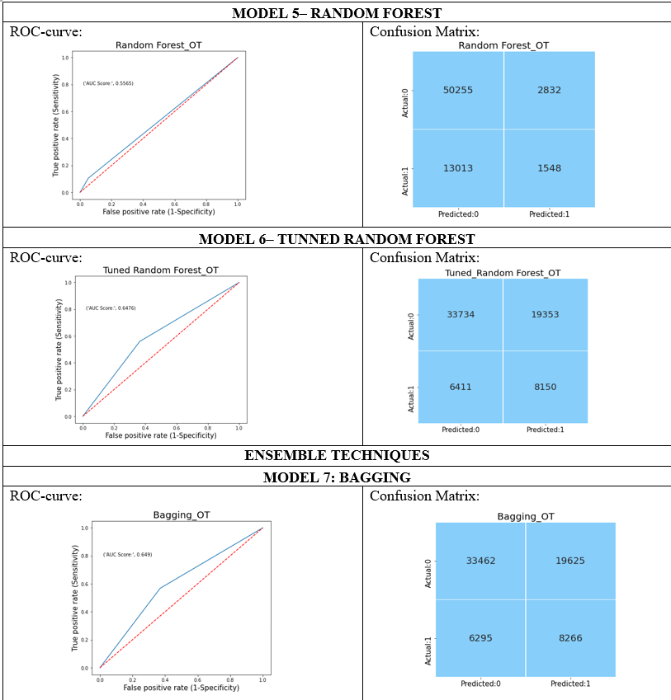
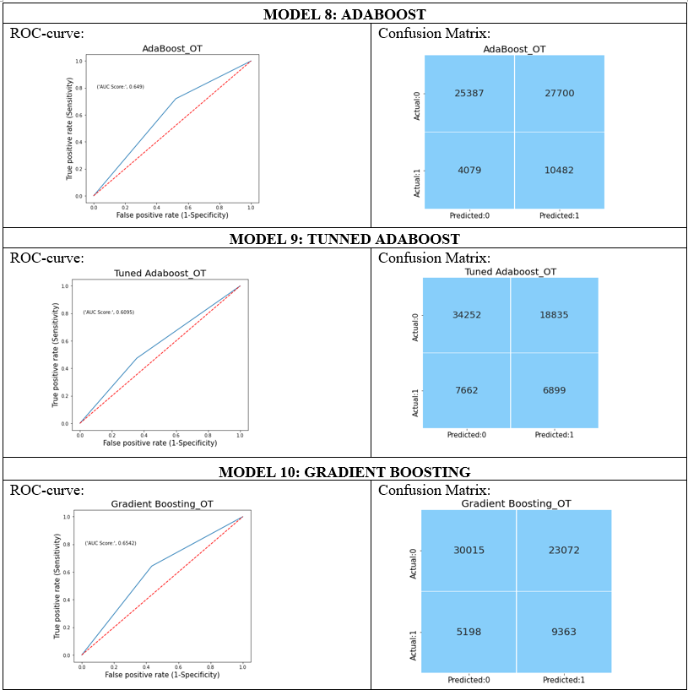
Various Models

Slide 13
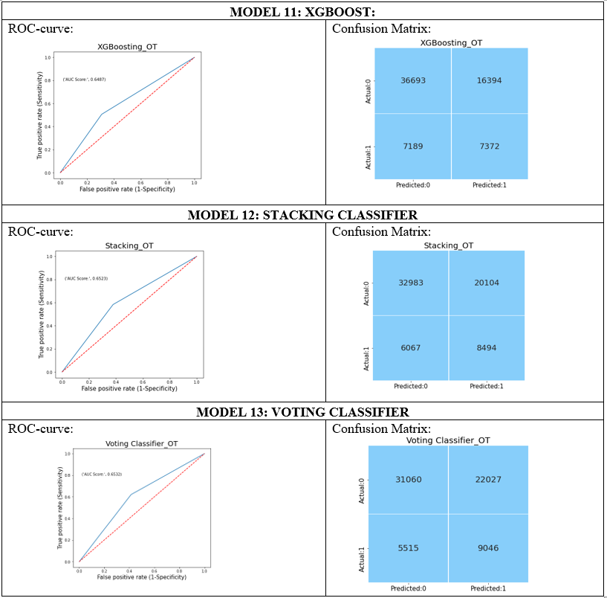
Various Models

Slide 14
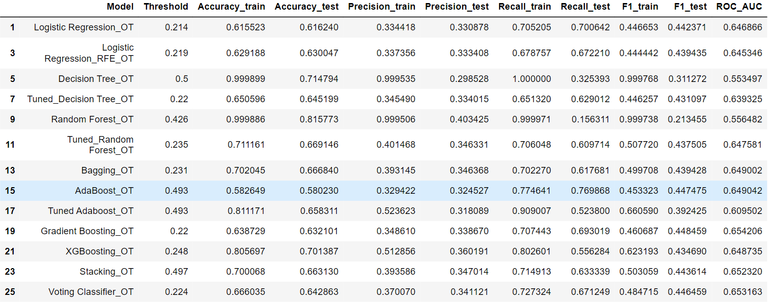
Comparison of Performance Metrics for various models Different Models
From above , we can see that AdaBoost Model, has better Recall value and better ROC-Curve value.
Hence we can use that as our Best Model

Slide 15
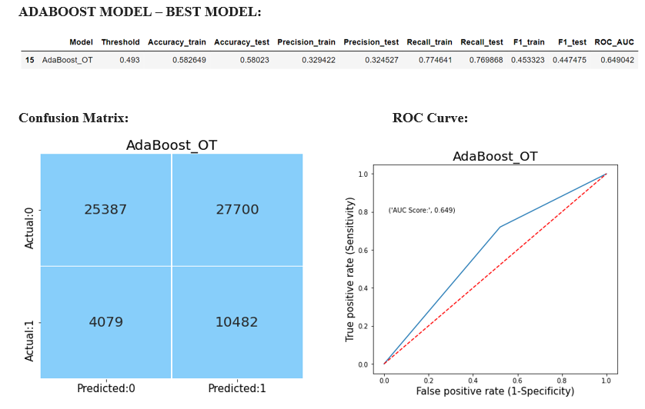
MODEL EVALUATION
Using accuracy as a defining metric for our model does make sense intuitively, but more often, it is always advisable to use Precision and Recall too.
Ideally, for our model, we would like to completely avoid any situations where the customer is actually a defaulter, however our model classifies the customer as non-defaulter. This is indeed a dangerous problem, we encountered during our model evaluation.
This thereby drives our aim to achieve a high recall score, which is more than that of Precision. (Maximum True Positive)
We have also reflected on the case where our model predicts non-defaulters as defaulters which in turn affects the business revenue of banks. Hence, we also aim for higher ROC-AUC curve area.
From our Model Performance metrics, we find AdaBoost Model as the best model since it has comparatively high Recall and F1 score value with moderate ROC-AUC curve.

Slide 16
BUSINESS INTERPRETATION
Limitations of our model
Some of the limitations of our model is that our dataset includes numbers/location code for location id, rather than the names of states/regions, where the bank branches are based. We encountered a limitation here, as the defaulters and the rate of defaults could have been predicted in a better manner, if the dataset had included exact state names for where the bank branches were located, instead of an id.
Furthermore, we can predict the rate of defaults, through our model with about 77% efficiency, however in real-world, this may still not be enough for the financial institutions to decide on disbursing loans, as there is still a 23% chance for banks to make a wrong decision, which is a high probability in real-world scenario.
Potential impact of our model
Our solution is impactful in making banks make better decisions about loan disbursement and who to disburse the loans to. This shall help in reducing the NPAs in our country.
Through our model, the loan defaulters can be predicted with about 77% accuracy. Our recommendation is that banks should feed the model with information (such as the variables used in our model), to predict whether a potential borrower would be able to replay the loan or not and thus make informed decisions about lending.
Conclusion
During this process, we have learnt to execute various models such as logistic regression, decision tree and ensemble techniques such as bagging and boosting, making us equipped with the different approaches followed by different models to reach the most precise metric value for our model.
Next time, we would like to choose a better dataset, which can provide us with more information on certain variables such as location of the banks.

Slide 17
Thanks!

